Slide 1
Advancement in UAV Technology
Prof M S Prasad Institute of Space Science & Technology
Amity University, Noida

Slide 2
Technology Area
Size & Complexity
Small & Complex Design
Mission Profiles
Manual
Autonomous
Semi Autonomous

Slide 3
Size & Complexity(SWAP)
Small Size Drones like insert
Complex in Design to Perform Complex Maneuver
Power System & Recharging Facility
Computer on Module (COM)

Slide 4
Communication Module
On Board Systems
Processing Unit
Navigation Sensors
Mission Sensors
Ground Control System
Swarm UAV’s

Slide 5
Application Areas
Visual Inspection of Aircraft
Mapping & Cartography
Scientific Research
Environment Monitoring
Wetlands
Waterways
Agriculture
Infrastructure Inspection/Structure Analysis
Emergency Response
Accessibility to Remote Communities

Slide 6
Drone Detection & Navigation
Real Time Detection Capabilities
Tracking Array Antenna & Spectrum Analysis
Vision Based Navigation
Autonomous System
Fault Tolerant Software Systems

Slide 7
Data Communication
High Resolution 4k HD Video
High Speed Backbone with Avionics Interface
Project DYNAMO : Seamless
Integration of Manned & Unmanned Comm.

Slide 8
INTEGRATION STRATEGY
SAFE Integration & Adoption Management
Air Navigation
ATC
Appropriate Rules & Regulation
Collision Avoidance Systems
Intel “Real Sense”
Low Cost Ads-B System

Slide 9
Autonomous Missions (Pre Programmed)
GPS Way Points Based
Vision Based
Obstacle Avoidance
Android/Smart Phone Controlled
Pre-programmed Camera

Slide 10
Future Trends
Fidelity e.g. 4k Video Camera
High Speed Down Links
Sensors
Stereoscopies, Lidar, IR
Mobility (Shift from Desktop to mobile Apps)

Slide 11
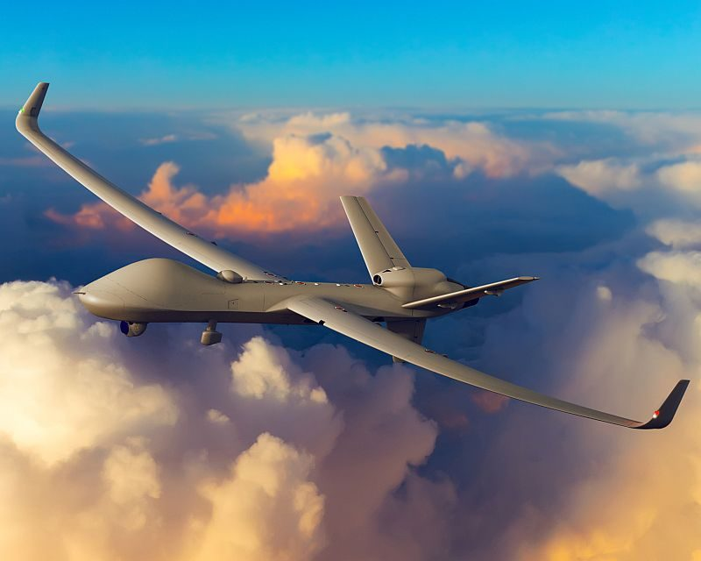

Slide 12
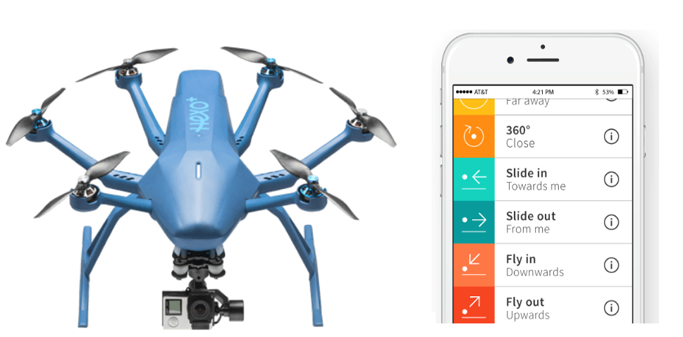
Hexo+ : flies autonomous missions. n Android or iPhone Smartphone.
The associated app enables pilots to select a number of preprogrammed flights so video and image shots can be staged easily. In other words, not only is the mission automated, so is the camera position.

Slide 13
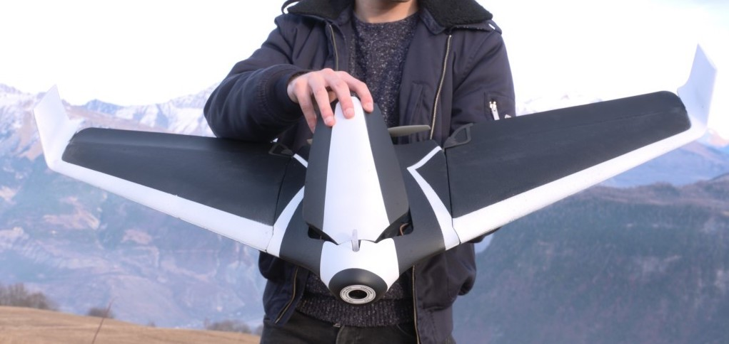
A fixed-wing drone that can fly 50 mph for 45 minutes on a single charge. The nose camera can record 1080p video or 14 megapixel images .

Slide 14
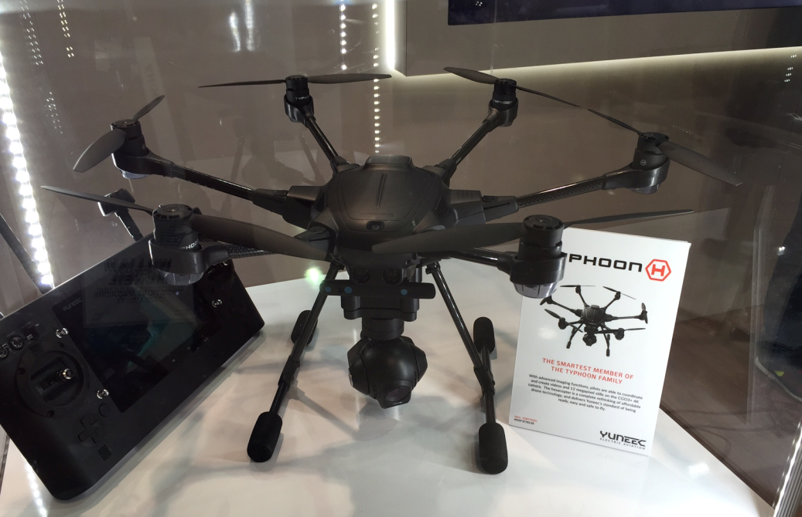
Typhoon H hexacopter. It has retractable and folding landing gear, with a camera that takes both 4K videos and 12-megapixel stills. The drone is powered by Intel's RealSense, which allows it to avoid collisions in real time, even when flying among trees and other dense obstacles.

Slide 15
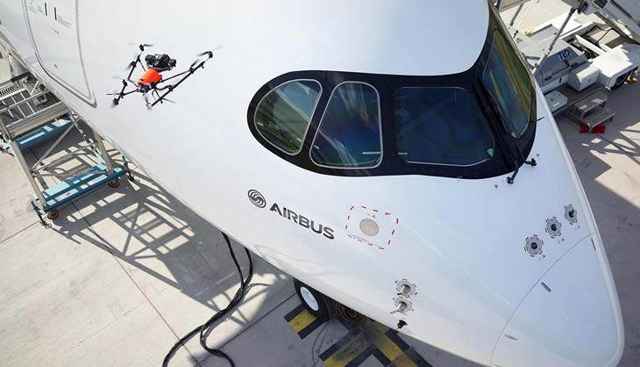
V-form octocopter performed a visual inspection on the upper part of the airliner using RealSense cameras for intelligent obstacle navigation and a 42-megapixel full-frame camera for data capturing.

Slide 16
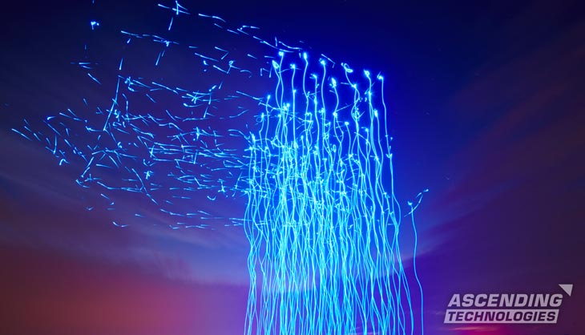
The individual 100 drones are all Quadcopter type AscTec Hummingbirds, controlled by pre-programmed software. They are synchronized to the music : Hamburg 2015

Slide 17
Safely Integrating
Unmanned Aircraft
A requirement to avoid operating unmanned aircraft over people;
A requirement for non-recreational remote pilots to pass a written knowledge test and to go through the same security vetting process as traditional manned-aircraft pilots;
A requirement for unmanned aircraft to stay at least 5 miles from airports and, among other reasonable restrictions, generally fly at an altitude below 400 feet,
creating a safe buffer between unmanned and manned aircraft, which can generally fly no lower than 500 feet; and
A requirement for remote pilots to keep unmanned aircraft within visual sight.
Developing air traffic management for low-altitude unmanned aircraft:
Engaging the government and the public on the future of unmanned aircraft

Slide 18
Ambarella just announced two new low-power chips for flight control, data transfers and image stabilization.
Qualcomm introduced Snapdragon Flight, a digital signal processor for flight control, with WiFi, Bluetooth, GPS and support for different sensors

Slide 19
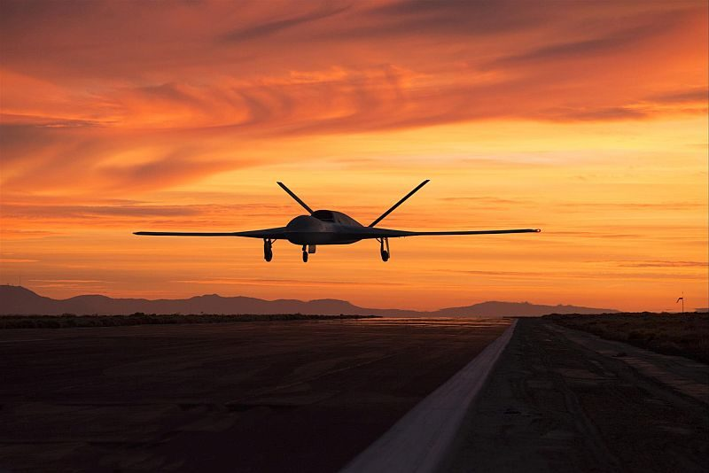
Thanks For Your Time
ANY Q

